Slide 1


Kick-off presentation
ASSESSMENT OF MACHINE LEARNING MODELS FOR SLM-BUILT 316L STAINLESS STEEL PROPERTY PREDICTION​
TEAM: AI CHEMISTS

Slide 2


TABLE OF
CONTENT
01
02
03
04
INTRODUCTION
METHODOLOGY
WORK DISTRIBUTION
PROJECT ROADMAP

Slide 3


INTRODUCTION
Reference Material that will be used for this study; contains the input data for the project

Slide 4
Research Aim
To compare the performance of machine learning techniques for predicting the surface roughness and mechanical properties of a stainless-steel specimens produced by selective laser melting (SLM).
Enhancing 3D Printing Quality: Improve the quality of 316L stainless steel parts produced through selective laser melting (SLM).
Efficiency Through Data: Use data-driven approaches to reduce errors and save resources in the 3D printing process.
Selecting the Best Model: Evaluate and compare various machine learning models to determine which one is most effective for predicting different property variables.
Advancing Manufacturing: Contribute to making 3D printing more efficient and reliable for industries using SLM technology.

Slide 5
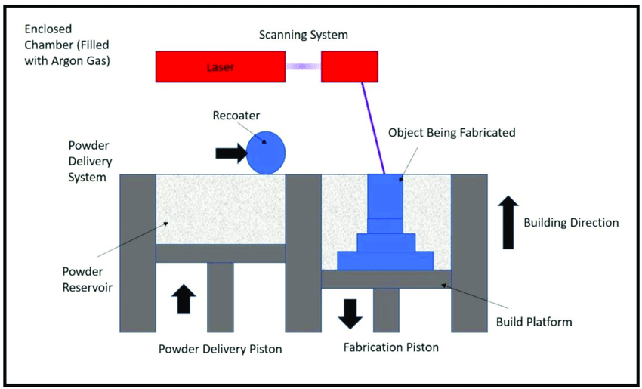
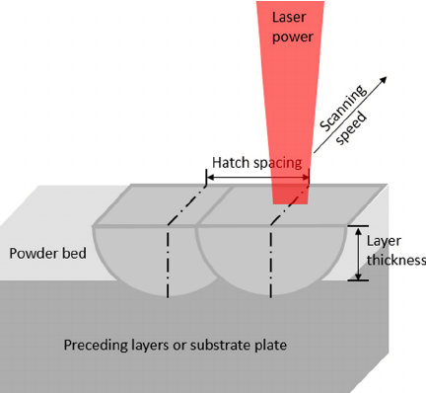
Selective Laser Melting (SLM) - An Overview
A
B
C
D
(DOI:10.3390/nano8080601)
SLM Process Parameters
(DOI:10.1063/1.4935926)

Slide 6
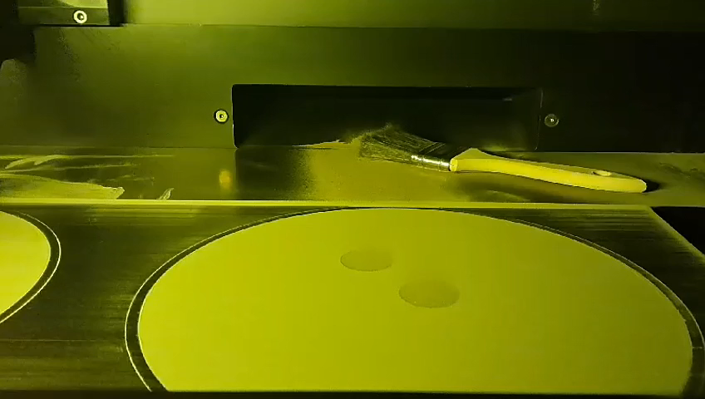
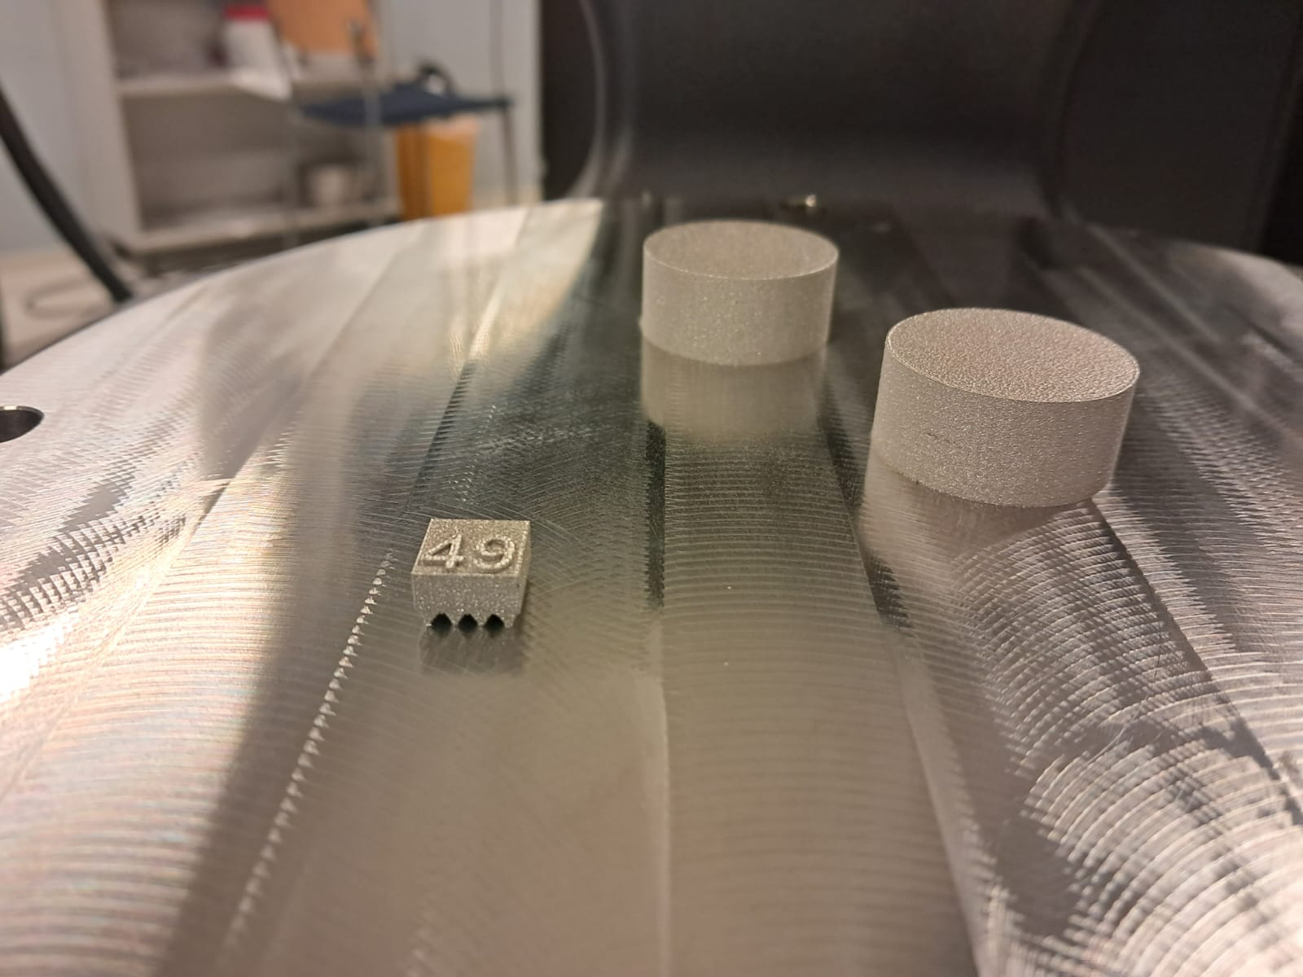

Demonstration of the Process
SLM-printed 316 L steel samples
Ongoing SLM process for printing 316 L steel samples

Slide 7

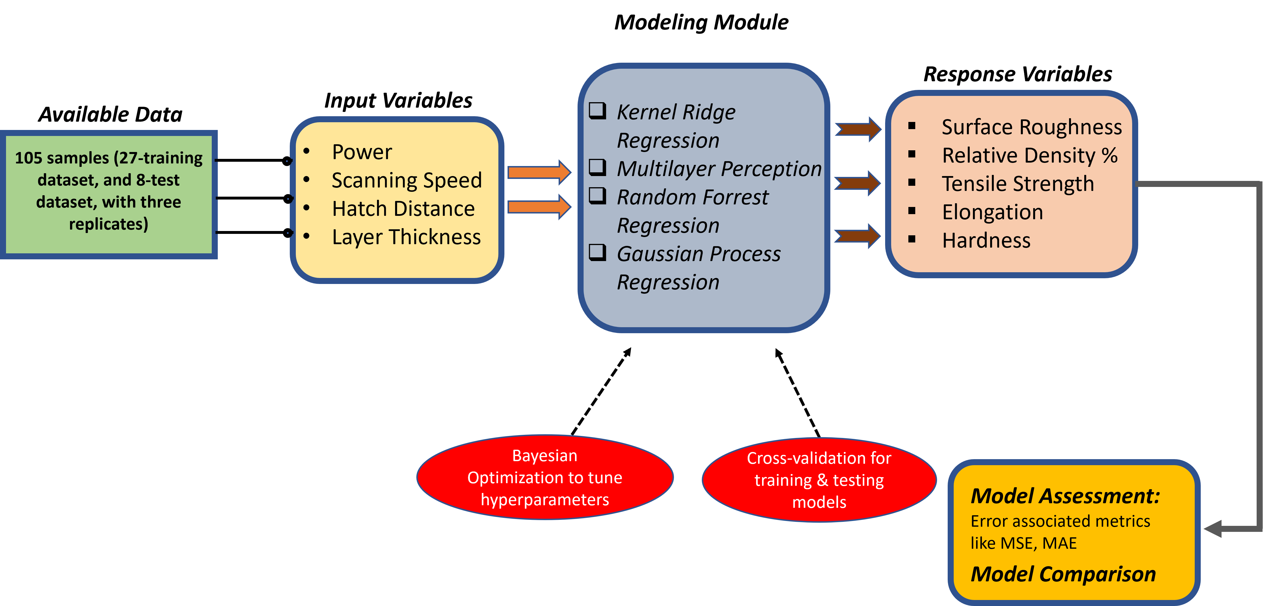
Methodology

Slide 8

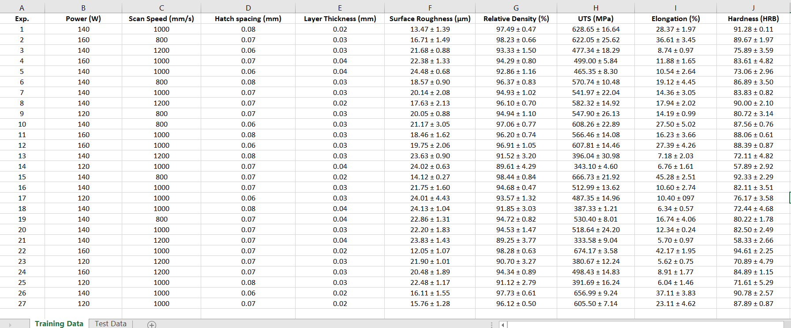
Training Data Set
Input Variables
Output Variables

Slide 9

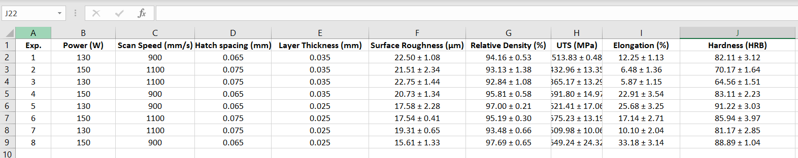
Test Data Set
Input Variables
Output Variables
Process Parameters defined by the user
Surface and mechanical properties of as-built parts calculated by using different lab equipment

Slide 10

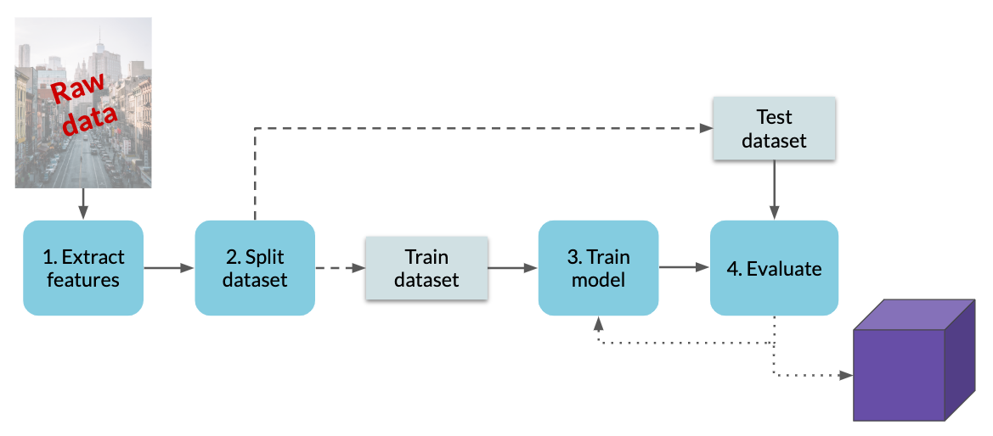
Work Distribution
Gaussian Process Regression - Toni & Sanni​
Multi-Layer Perception (NN) – Ruslan​
Random Decision Trees – Ransell​
Kernel Ridge Regression – Abhinav
Modelling Module

Slide 11



4th December
Project roadmap
PROJECT FINAL PRESENTATION
20th November
13th November
PROJECT CONSULTATION MEETING
20th Nov - 3rd Dec
PROJECT MID-POINT PRESENTATION
TEAM MEETINGS
Finishing touches
6th - 12th Nov
TEAM MEETING
Working with each ML model
30th Oct - 5th Nov
23th October
TEAM MEETING
PROJECT KICK-OFF PRESENTATION
Researching your own ML methods
Introducing our project to other ML groups.

